Slide 1

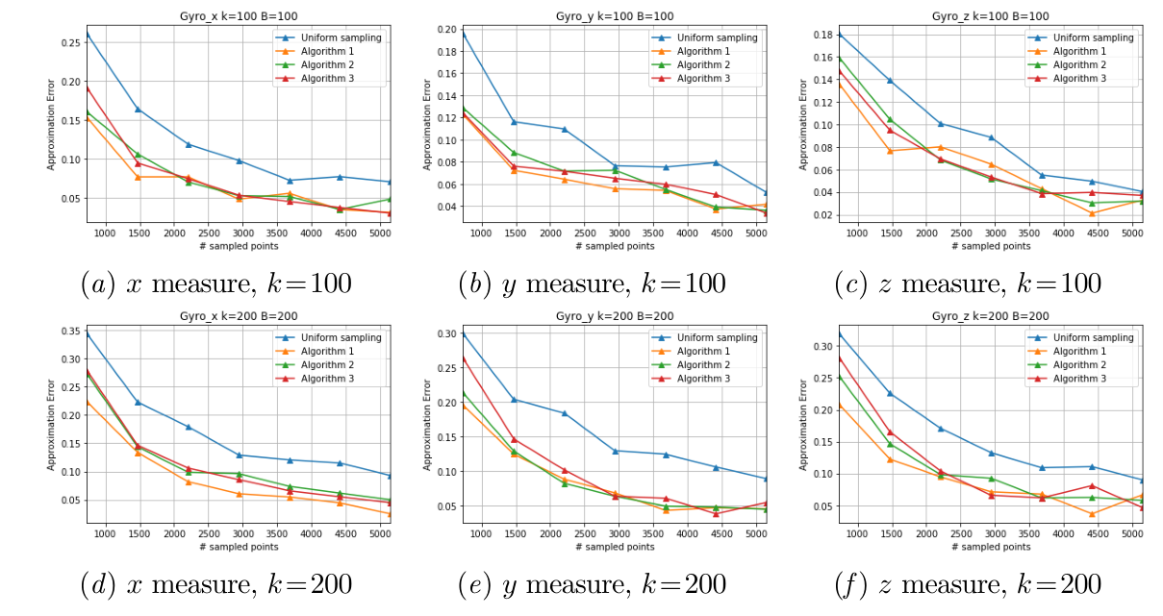
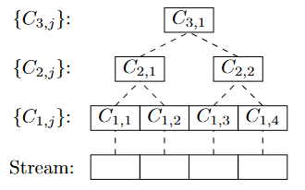
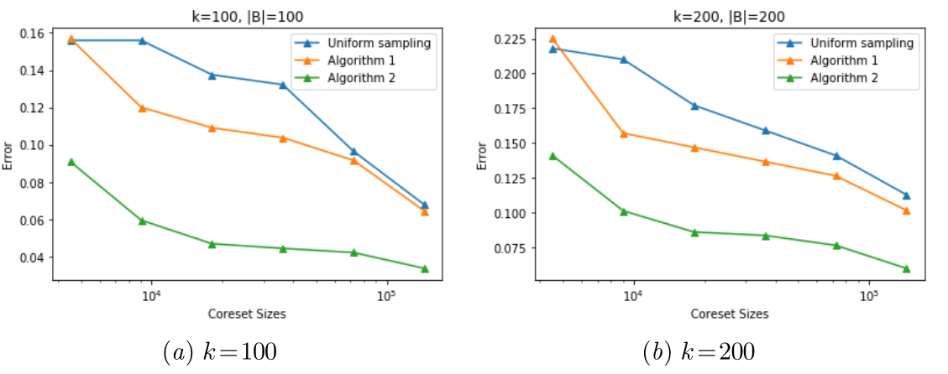
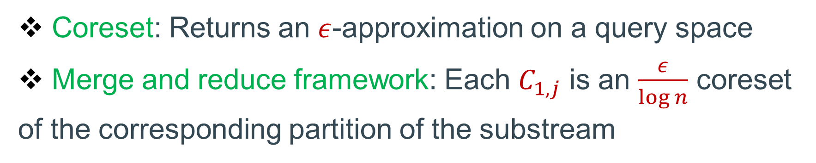
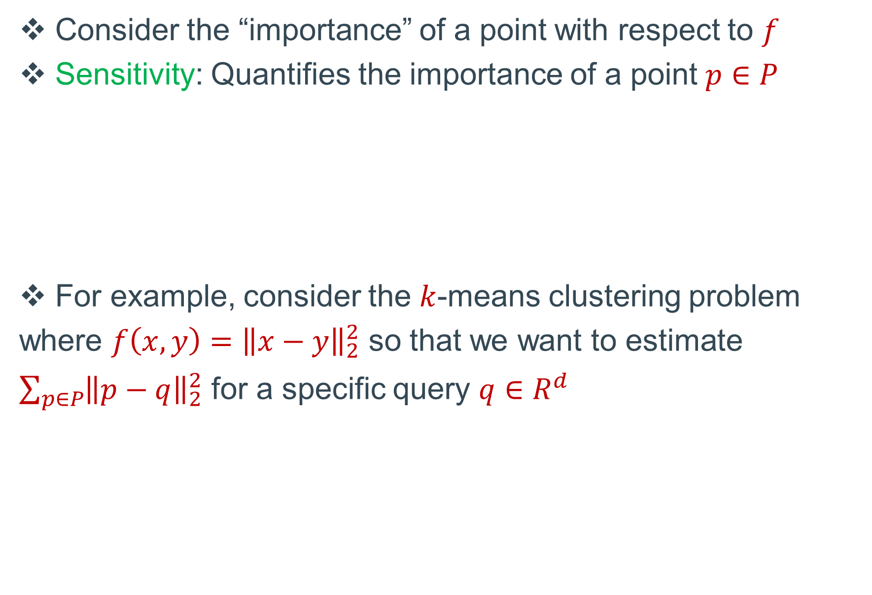
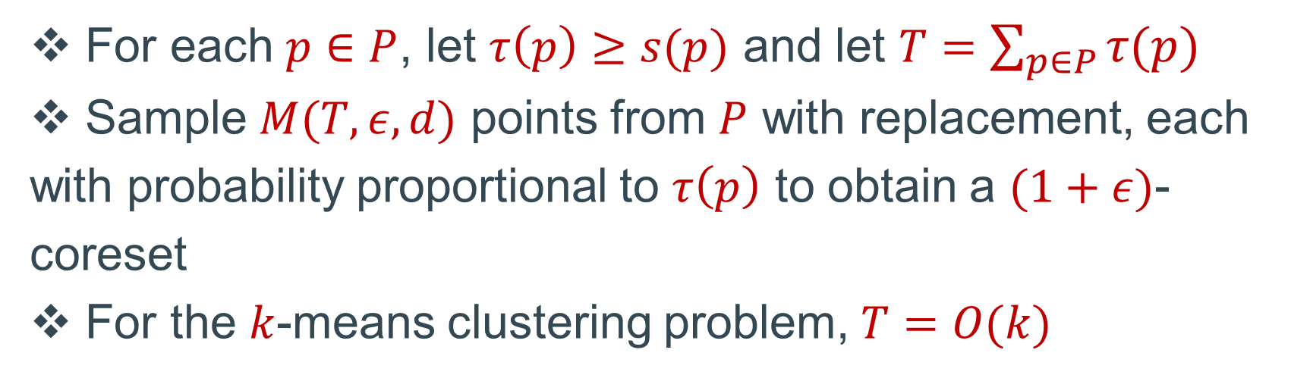
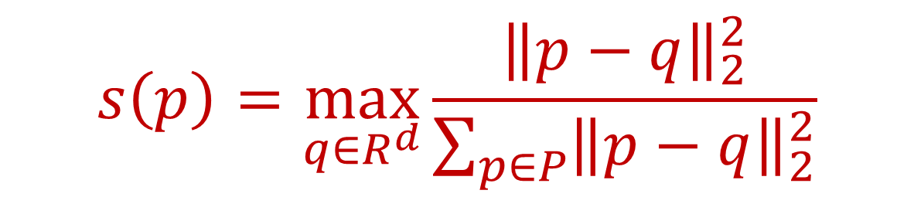
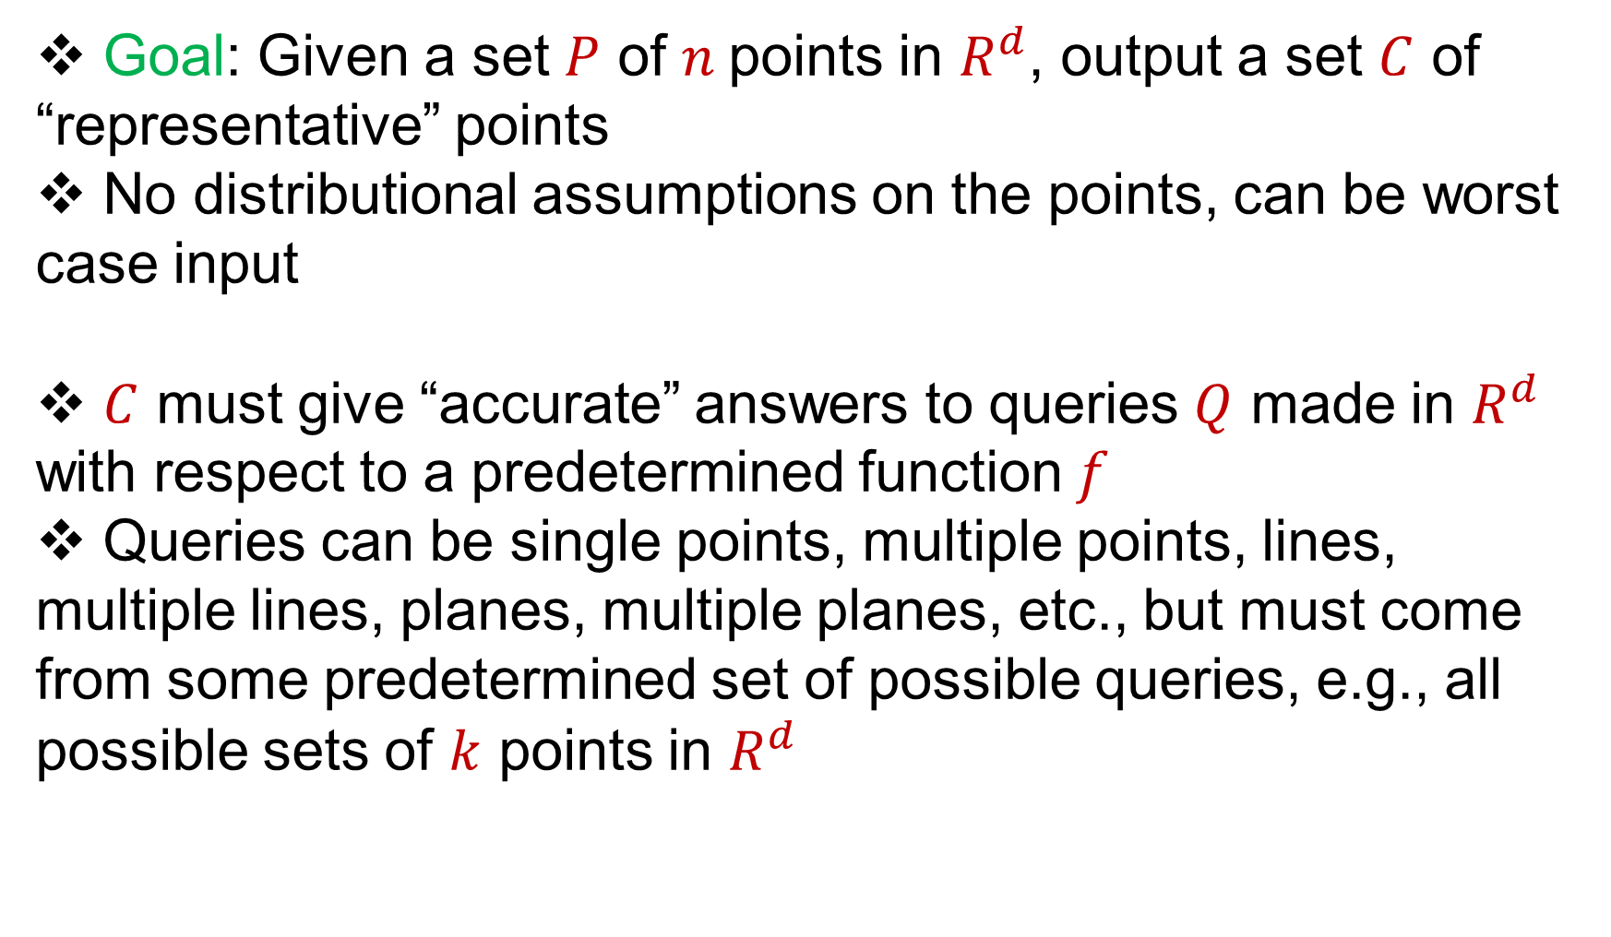
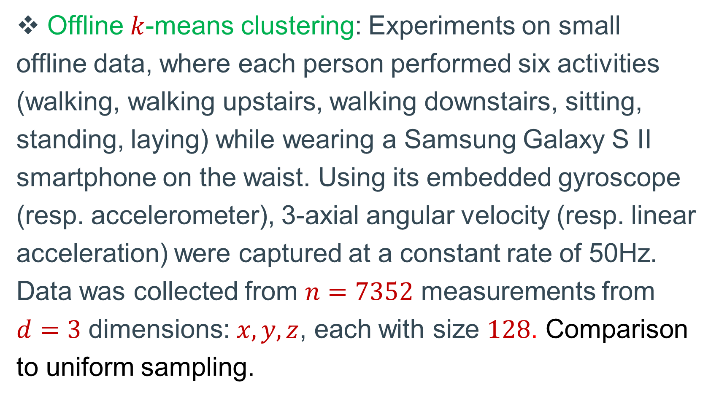
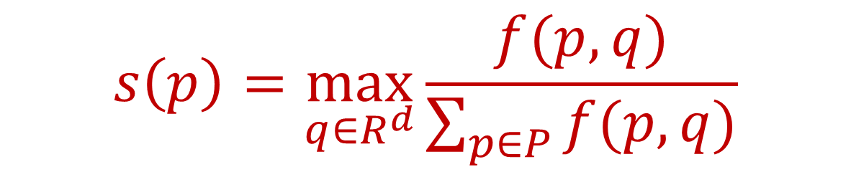
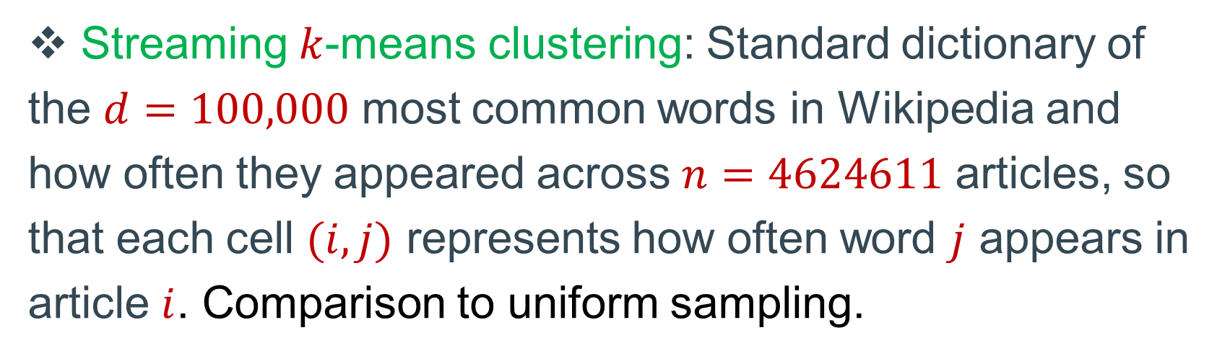
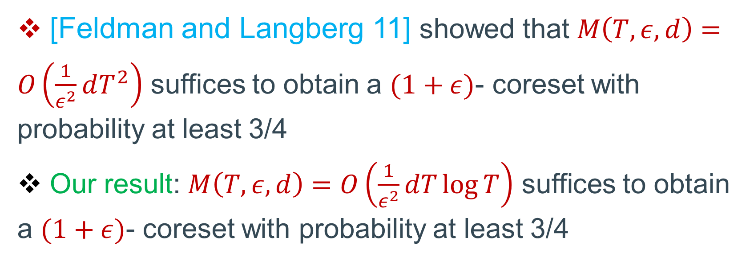
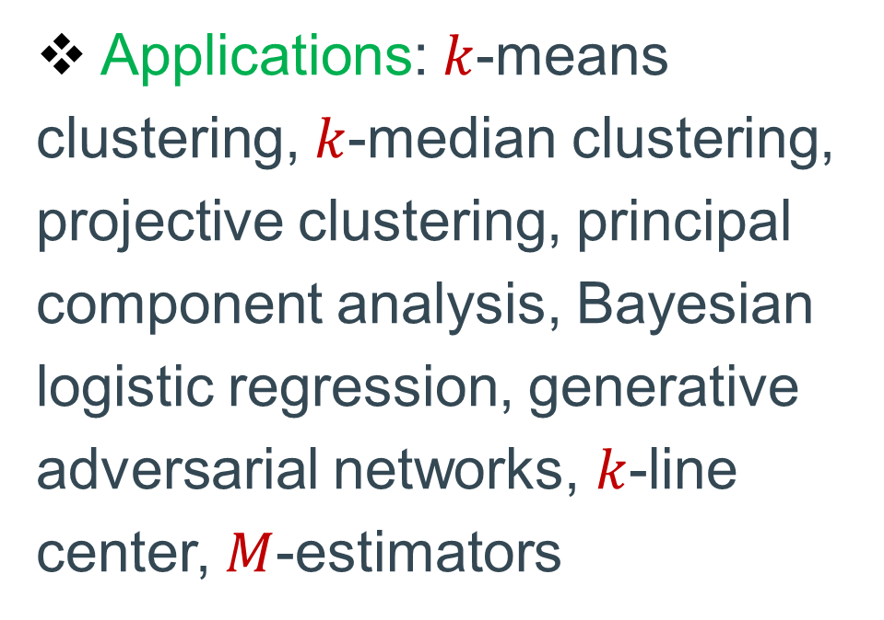
Efficient Coreset Constructions via Sensitivity Sampling
Vladimir Braverman (Johns Hopkins University)
Dan Feldman (University of Haifa)
Harry Lang (MIT)
Adiel Statman (University of Haifa)
Samson Zhou (Carnegie Mellon University)
Model
Empirical Evaluations
Sensitivity
Offline $k$-means clustering: Experiments on small offline data, where each person performed six activities (walking, walking upstairs, walking downstairs, sitting, standing, laying) while wearing a Samsung Galaxy S II smartphone on the waist. Using its embedded gyroscope (resp. accelerometer), 3-axial angular velocity (resp. linear acceleration) were captured at a constant rate of 50Hz. Data was collected from $n=7352$ measurements from $d=3$ dimensions: $x,y,z$, each with size $128$. Comparison to uniform sampling.
Goal: Given a set $P$ of $n$points in $R^{d}$, output a set $C$ of “representative” points
No distributional assumptions on the points, can be worst case input
$C$ must give “accurate” answers to queries $Q$ made in $R^{d}$ with respect to a predetermined function $f$
Queries can be single points, multiple points, lines, multiple lines, planes, multiple planes, etc., but must come from some predetermined set of possible queries, e.g., all possible sets of $k$ points in $R^{d}$
Consider the “importance” of a point with respect to $f$
Sensitivity: Quantifies the importance of a point $p∈P$
For example, consider the $k$-means clustering problem where $f\left(x,y\right)={\left\|x−y\right\|}_{2}^{2}$ so that we want to estimate $\sum_{p∈P}{{\left\|p−q\right\|}_{2}^{2}}$ for a specific query ${q∈R}^{d}$
$$s\left(p\right)=\max_{q∈R^{d}}{\frac{f(p,q)}{\sum_{p∈P}{f(p,q)}}}$$
Coresets
$$s\left(p\right)=\max_{q∈R^{d}}{\frac{{\left\|p−q\right\|}_{2}^{2}}{\sum_{p∈P}{{\left\|p−q\right\|}_{2}^{2}}}}$$
Coreset: Returns an $ε$-approximation on a query space
Merge and reduce framework: Each $C_{1,j}$ is an $\frac{ε}{\log{n}}$ coreset of the corresponding partition of the substream
Applications: $k$-means clustering, $k$-median clustering, projective clustering, principal component analysis, Bayesian logistic regression, generative adversarial networks, $k$-line center, $M$-estimators
Sensitivity Sampling
For each $p∈P$, let $τ\left(p\right)≥s(p)$ and let $T=\sum_{p∈P}{τ(p)}$
Sample $M(T,ε, d)$ points from $P$ with replacement, each with probability proportional to $τ\left(p\right)$ to obtain a $(1+ε)$- coreset
For the $k$-means clustering problem, $T=O(k)$
Streaming $k$-means clustering: Standard dictionary of the $d=100,000$ most common words in Wikipedia and how often they appeared across $n=4624611$ articles, so that each cell $(i,j)$ represents how often word $j$ appears in article $i$. Comparison to uniform sampling.
Motivation
Results and Related Work
Runtime: Faster algorithms downstream
Space: Space used to store the data is decreased
Communication: Size/number of messages passed between multiple parties is decreased
Dimensionality Reduction: Each point in the coreset can be further optimized by dimensionality reduction techniques if applicable, e.g., Johnson-Lindenstrauss transformation
[Feldman and Langberg 11] showed that $M\left(T,ε, d\right)=O\left(\frac{1}{ε^{2}}dT^{2}\right)$ suffices to obtain a $(1+ε)$- coreset with probability at least 3/4
Our result: $M\left(T,ε, d\right)=O\left(\frac{1}{ε^{2}}dT\log{T}\right)$ suffices to obtain a $(1+ε)$- coreset with probability at least 3/4

